Slide 1
What Is E-commerce?
Use of Internet and Web to transact business
More formally:
  Digitally enabled commercial transactions between and among organizations and individuals

Slide 2
E-commerce vs. E-business
E-business:
  Digital enabling of transactions and processes within a firm, involving information systems under firm’s control
  Does not include commercial transactions involving an exchange of value across organizational boundaries

Slide 3
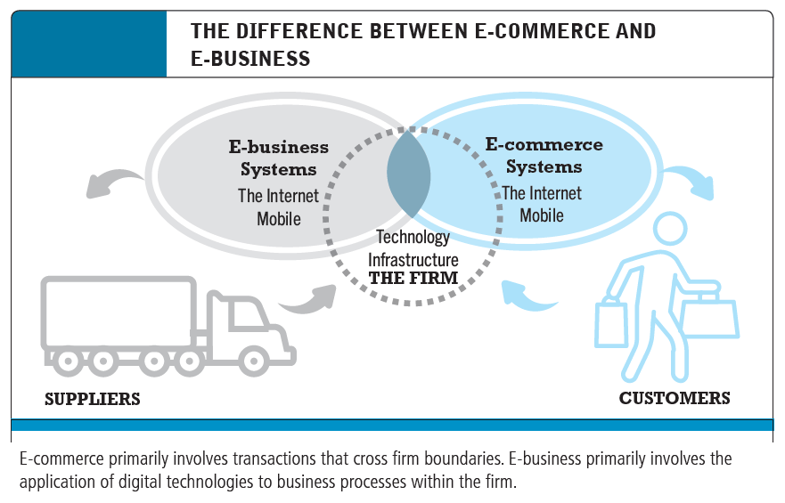
E-commerce vs. E-business

Slide 4
Why Study E-commerce?
E-commerce technology is different, more powerful than previous technologies
E-commerce brings fundamental changes to commerce
Traditional commerce:
  Consumer as passive targets
  Mass-marketing driven
  Sales-force driven
  Fixed prices
  Information asymmetry

Slide 5
Consumers as Passive targets
Meaning:
In traditional commerce, consumers are seen as passive recipients of products or marketing messages. Businesses push products toward them without much input or interaction from the consumers.
Illustration:
Think of a 1990s TV commercial for a shampoo. The brand airs the ad repeatedly during prime time. Viewers just watch it—they have no direct way to ask questions or compare products instantly. Their role is passive: watch, remember, and maybe buy.

Slide 6
Mass-marketing driven
Meaning:
Businesses use one-size-fits-all marketing strategies to reach as many people as possible with the same message, regardless of individual preferences.
Illustration:
A newspaper ad promoting a new car model is seen by thousands of readers, even though only a small fraction might be interested. The ad is not tailored to any specific group—just broadly targeted.

Slide 7
Sales-force driven
Meaning:
Salespeople play a central role in persuading customers to buy. The business often relies on personal selling more than product value or customer need.
Illustration:
In traditional retail or door-to-door selling, a salesperson visits a potential buyer, gives a pitch, and convinces them to make a purchase, often using persuasive techniques.

Slide 8
Fixed prices
Meaning:
Prices are usually fixed by the seller with little to no room for negotiation. Customers must accept the set price or leave.
Illustration:
In a shopping mall or department store, a pair of jeans has a fixed price tag. Unlike in some local markets, there's no haggling or personalized pricing.

Slide 9
Information asymmetry
Meaning:
The seller knows much more about the product than the buyer. The buyer depends heavily on the seller’s words and has limited ability to verify information.
Illustration:
When buying a second-hand car from a dealership in the 1980s, the buyer may not know if the car was in an accident. The seller has more information, and the buyer has little way to verify unless they bring an expert.

Slide 10
Eight Unique Features of
E-commerce Technology
Ubiquity
Global reach
Universal standards
Information richness
Interactivity
Information density
Personalization/customization
Social technology

Slide 11
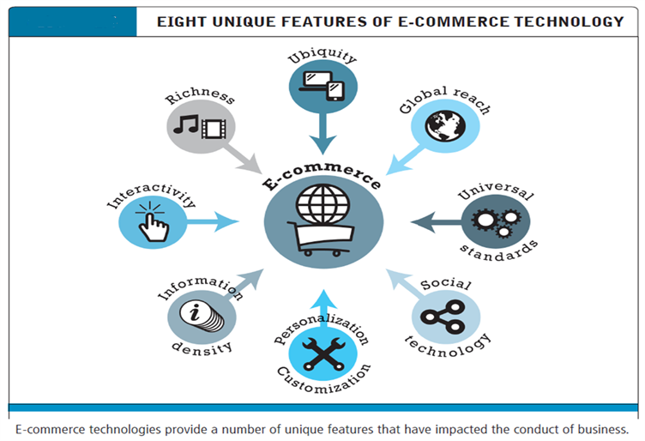
Eight Unique Features of
E-commerce Technology

Slide 12
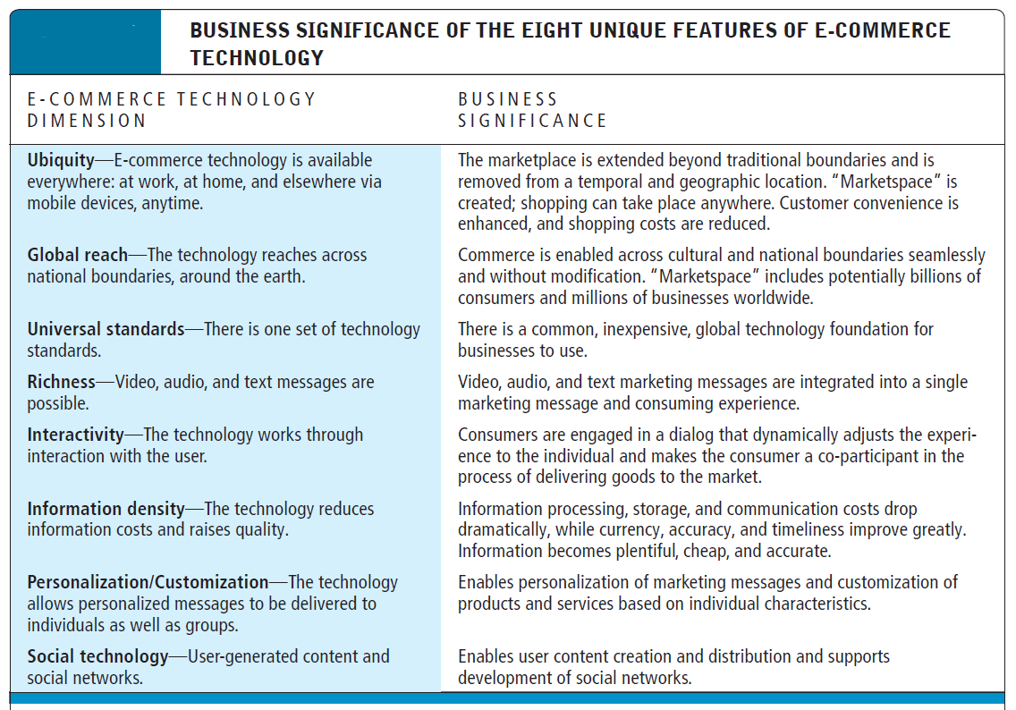
Eight Unique Features of
E-commerce Technology

Slide 13
Ubiquity – “Available everywhere, at any time”
In traditional commerce, you had to go to the store during specific hours to shop. In e-commerce, the store comes to you, and it's open 24/7—wherever you are.
Supermarket vs. Online Grocery
Traditional: You need to visit a supermarket (e.g., Agora or Meena Bazar in Bangladesh), wait in line, and shop during their open hours.
E-commerce: You can order from Chaldal.com anytime—early morning or midnight—from your phone while lying in bed. Delivery comes to your door.

Slide 14
Physical Ticket Counter vs. Online Booking
Traditional: Buying a bus or train ticket meant standing in line at the station.
E-commerce: Use Shohoz.com or Busbd.com to book tickets online anytime—even while riding another bus!
Shopping Mall vs. E-commerce App
Traditional: You go to a shopping mall during opening hours.
E-commerce: Open the Daraz app from your living room or a tea stall and buy what you need in minutes.

Slide 15
Global Reach – “E-commerce can reach across national boundaries, to customers worldwide”
Traditional commerce is often limited to local or regional customers due to physical, legal, or logistical barriers. But e-commerce breaks down those walls—you can sell or buy products from almost any country in the world.
Supermarket vs. Online Grocery
Traditional: You need to visit a supermarket (e.g., Agora or Meena Bazar in Bangladesh), wait in line, and shop during their open hours.
E-commerce: You can order from Chaldal.com anytime—early morning or midnight—from your phone while lying in bed. Delivery comes to your door.

Slide 16
Local Shop vs. Etsy Seller
Traditional: A craftsman in Rajshahi makes jute handbags and sells them at the local market. Only local buyers can purchase them.
E-commerce: The same craftsman sells his bags on Etsy.com. Now, customers from Canada, France, or Japan can find, order, and pay online.
Local Author vs. E-book Publisher
Traditional: An author publishes a book and sells it through bookstores in Dhaka only.
E-commerce: Using Amazon Kindle Direct Publishing, the same author uploads an e-book. Readers in London, Nairobi, and Toronto can instantly download and read it.

Slide 17
Universal Standards – “E-commerce technologies use globally accepted technical standards that apply to all users and platforms”
This means that everyone uses the same rules, protocols, and formats when engaging in e-commerce—whether they’re in the USA, Bangladesh, or Japan. This standardization makes it easy, fast, and cost-effective to build and use e-commerce platforms.
Web Browser Compatibility
Traditional World: Think of trying to play a cassette from Bangladesh on a machine in Europe—they might not match formats.
E-commerce World: A website built with HTML, CSS, and JavaScript in Dhaka opens perfectly in Chrome, Firefox, or Safari anywhere in the world.

Slide 18
Online Shopping Carts
A developer in India creates a shopping cart feature using HTTPS, cookies, and HTML forms.
It works flawlessly for a buyer in Germany using a Mac, and another in Brazil using an Android phone—because the standards behind the code are universal.
Online Payment Gateways
Whether you're paying with Visa, MasterCard, or PayPal, the payment protocols (like SSL encryption, HTTPS, JSON APIs) are standardized.
This allows any e-commerce site to integrate payment systems without custom setups for each country.
Mobile E-commerce Apps
Developers build an e-commerce app using React Native or Flutter, and the app works on both Android and iOS devices globally.

Slide 19
Information Richness – “E-commerce can deliver detailed, multimedia-rich information about products and services”
Compared to traditional commerce, where information is limited and basic, e-commerce can provide a deep, engaging experience using text, images, videos, audio, interactive tools, and more—all in one place.
Shoe Store vs. Online Product Page
Traditional: You walk into a shoe store and see shoes on the shelf. A salesperson gives a short pitch, but you can't see how the shoes are made or how they look on different people.
E-commerce: On Nike.com, you can see:
  Multiple images of the shoes from every angle
  A video showing how they perform during a run
  Customer reviews
  Size chart, material breakdown, FAQs

Slide 20
Phone Shop vs. Amazon Product Page
Traditional: You visit a mobile phone shop, hold the phone, and ask a few questions to the seller.
E-commerce: On Amazon, you can view:
  Detailed specifications
  Comparison with other phones
  User-generated Q&A
  Tutorial videos
  Star ratings and thousands of reviews
Restaurant Menu vs. Food Delivery App
Traditional: You go to a restaurant and read a plain text menu.
E-commerce: On Foodpanda or Uber Eats, you can:
  See pictures of each dish
  Watch short videos of how it's prepared
  Read customer ratings and reviews
  See allergy info and nutritional facts

Slide 21
Interactivity – “E-commerce enables two-way communication between buyers and sellers, making the shopping experience more engaging, responsive, and personalized.”
Unlike traditional media (like TV or newspapers), which are one-way communication, e-commerce allows two-way interactions. This means users can ask, respond, review, chat, customize, and more — right on the platform.
Customer support at a shop vs. Chatbot on a website
Traditional: You walk into a shop and ask the staff questions about a product.
E-commerce: On Daraz, Amazon, or AjkerDeal, you use a chatbot or live chat to ask: “Is this available in black?” or “Can it be delivered to my area?” and get an instant reply.

Slide 22
Interactivity – “E-commerce enables two-way communication between buyers and sellers, making the shopping experience more engaging, responsive, and personalized.”
Unlike traditional media (like TV or newspapers), which are one-way communication, e-commerce allows two-way interactions. This means users can ask, respond, review, chat, customize, and more — right on the platform.
Customer support at a shop vs. Chatbot on a website
Traditional: You walk into a shop and ask the staff questions about a product.
E-commerce: On Daraz, Amazon, or AjkerDeal, you use a chatbot or live chat to ask: “Is this available in black?” or “Can it be delivered to my area?” and get an instant reply.

Slide 23
Street shopping vs. Interactive product selection
Traditional: You hold a product, ask the seller if there’s a size or color, wait for their answer.
E-commerce: On Nike.com, you can click to switch colors, see different sizes, read reviews, or use tools to suggest your best fit.
Complaining in-store vs. Product reviews and seller responses
Traditional: You tell the manager in person that the product was bad.
E-commerce: On Amazon, you write a review: “The product broke in 3 days,” and the seller replies publicly offering a refund or a solution.
Asking friends for advice vs. Community Q&A
Traditional: You ask your friend, “Is this phone good?” before buying.
E-commerce: On Flipkart or AliExpress, there’s a Q&A section where users ask: “Is this camera waterproof?” and real buyers answer, “Yes, I tested it underwater.”

Slide 24
Types of E-commerce
May be classified by market relationship or technology
Business-to-Consumer (B2C)
Business-to-Business (B2B)
Consumer-to-Consumer (C2C)
Social e-commerce
Mobile e-commerce (M-commerce)
Local e-commerce

Slide 25
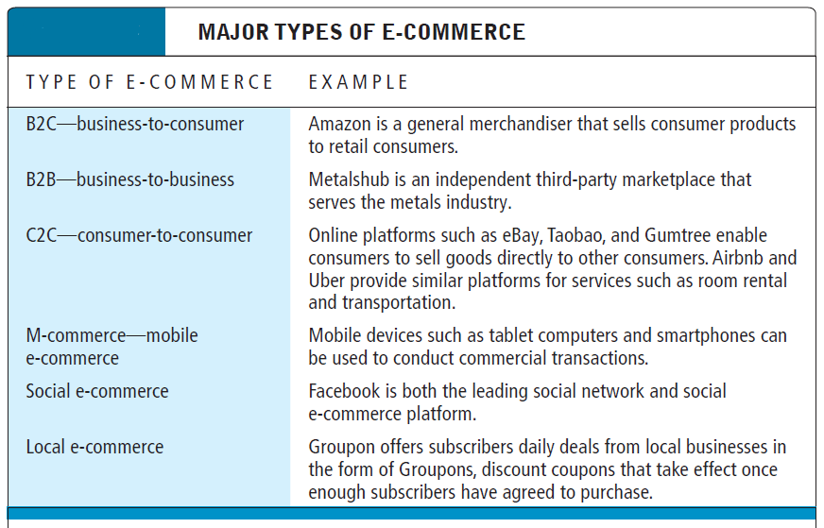
Types of E-commerce

Slide 26
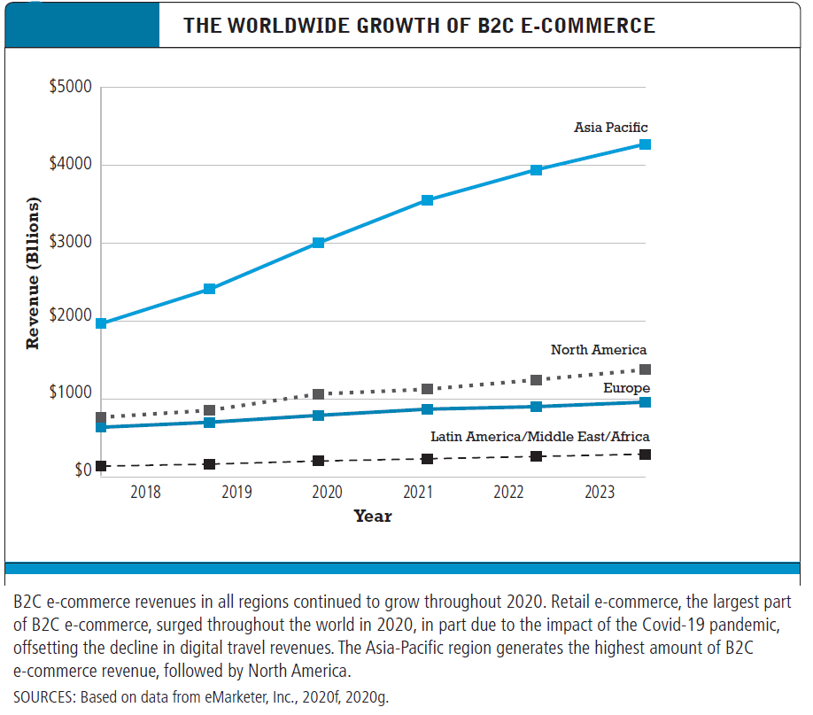
The Growth of B2C E-commerce

Slide 27
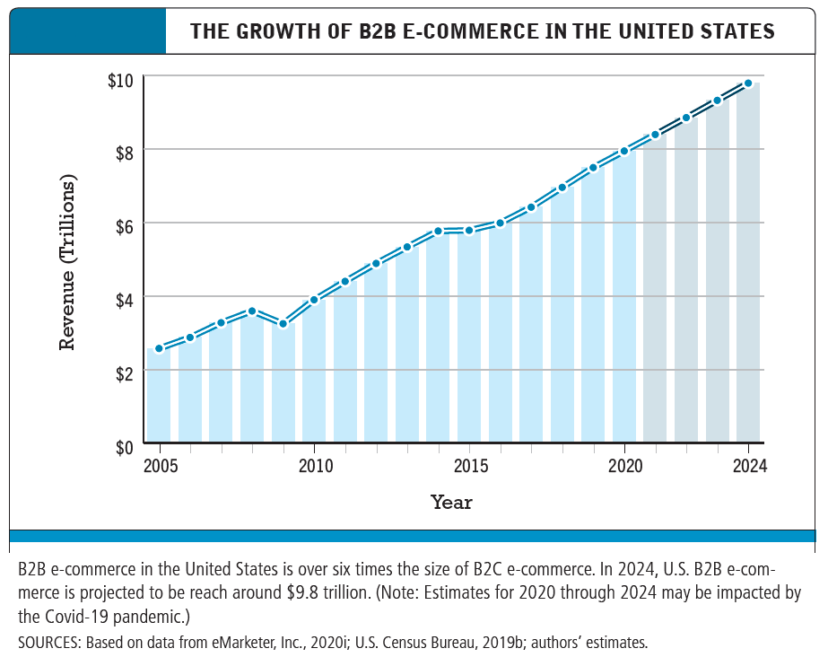
The Growth of B2B E-commerce

Slide 28
The Internet
Worldwide network of computer networks built on common standards
Created in late 1960s
Services include the Web, e-mail, file transfers, and so on
Can measure growth by number of Internet hosts with domain names

Slide 29
The Web
Most popular Internet service
Developed in early 1990s
Provides access to Web pages
  HTML documents that may include text, graphics, animations, music, videos
Web content has grown exponentially
  Google reports 30 trillion unique URLs; 120 billion Web pages indexed

Slide 30
The Mobile Platform
Most recent development in Internet infrastructure
Enables access to the Internet via wireless networks or cell-phone service
Mobile devices include
  Tablets
  Smartphones
  Ultra-lightweight laptops

Slide 31
Will Apps Make the Web Irrelevant?
What are the advantages and disadvantages of apps, compared with Web sites, for mobile users?
What are the benefits of apps for content owners and creators?
Will apps eventually make the Web irrelevant? Why or why not?

Slide 32
Origins and Growth of E-commerce
Precursors:
  Baxter Healthcare
  Electronic Data Interchange (EDI)
  French Minitel (1980s videotex system)
  None had functionality of Internet
1995: Beginning of e-commerce
  First sales of banner advertisements
E-commerce fastest growing form of commerce in United States

Slide 33
E-commerce: A Brief History
1995–2000: Invention
  Key concepts developed
  Limited bandwidth and media
  Euphoric visions of
    Friction-free commerce
      Lowered search costs, disintermediation, price transparency, elimination of unfair competitive advantage
    First-mover advantages
      Network profits
  Dot-com crash of 2000

Slide 34
E-commerce: A Brief History (cont.)
2001–2006: Consolidation
  Emphasis on business-driven approach
  Traditional large firms expand presence
  Start-up financing shrinks up
  More complex products and services sold
  Growth of search engine advertising
  Business Web presences expand to include e-mail, display and search advertising, and limited community feedback features

Slide 35
E-commerce: A Brief History (cont.)
2007–Present: Reinvention
  Rapid growth of:
    Online social networks
    Mobile platform
    Local commerce
  Entertainment content develops as source of revenues
  Transformation of marketing
    Coordinated marketing on social, mobile, local platforms
    Analytic technologies

Slide 36
Start-up Boot Camp
Why do you think investors today are still interested in investing in start-ups?
What are the benefits of investing in a company that is a graduate of a Y Combinator boot camp?
Is an incubator the best solution for start-ups to find funding? Why or why not?

Slide 37
Assessing E-commerce
Many early visions not fulfilled
  Friction-free commerce
    Consumers less price sensitive
    Considerable price dispersion
  Perfect competition
    Information asymmetries persist
  Intermediaries have not disappeared
  First mover advantages
    Fast-followers often overtake first movers

Slide 38
Predictions for the Future
Technology will propagate through all commercial activity
Large, traditional companies will continue to play dominant role, consolidating audiences
  Start-up ventures can still attract large audiences in non-dominated arenas
Integrated online/offline companies will experience more growth than purely online companies
Additional factors:
  Increased regulation and control
  Cost of energy

Slide 39
Understanding E-commerce: Organizing Themes
Technology:
  Development and mastery of digital computing and communications technology
Business:
  New technologies present businesses with new ways of organizing production and transacting business
Society:
  Intellectual property, individual privacy, public welfare policy

Slide 40
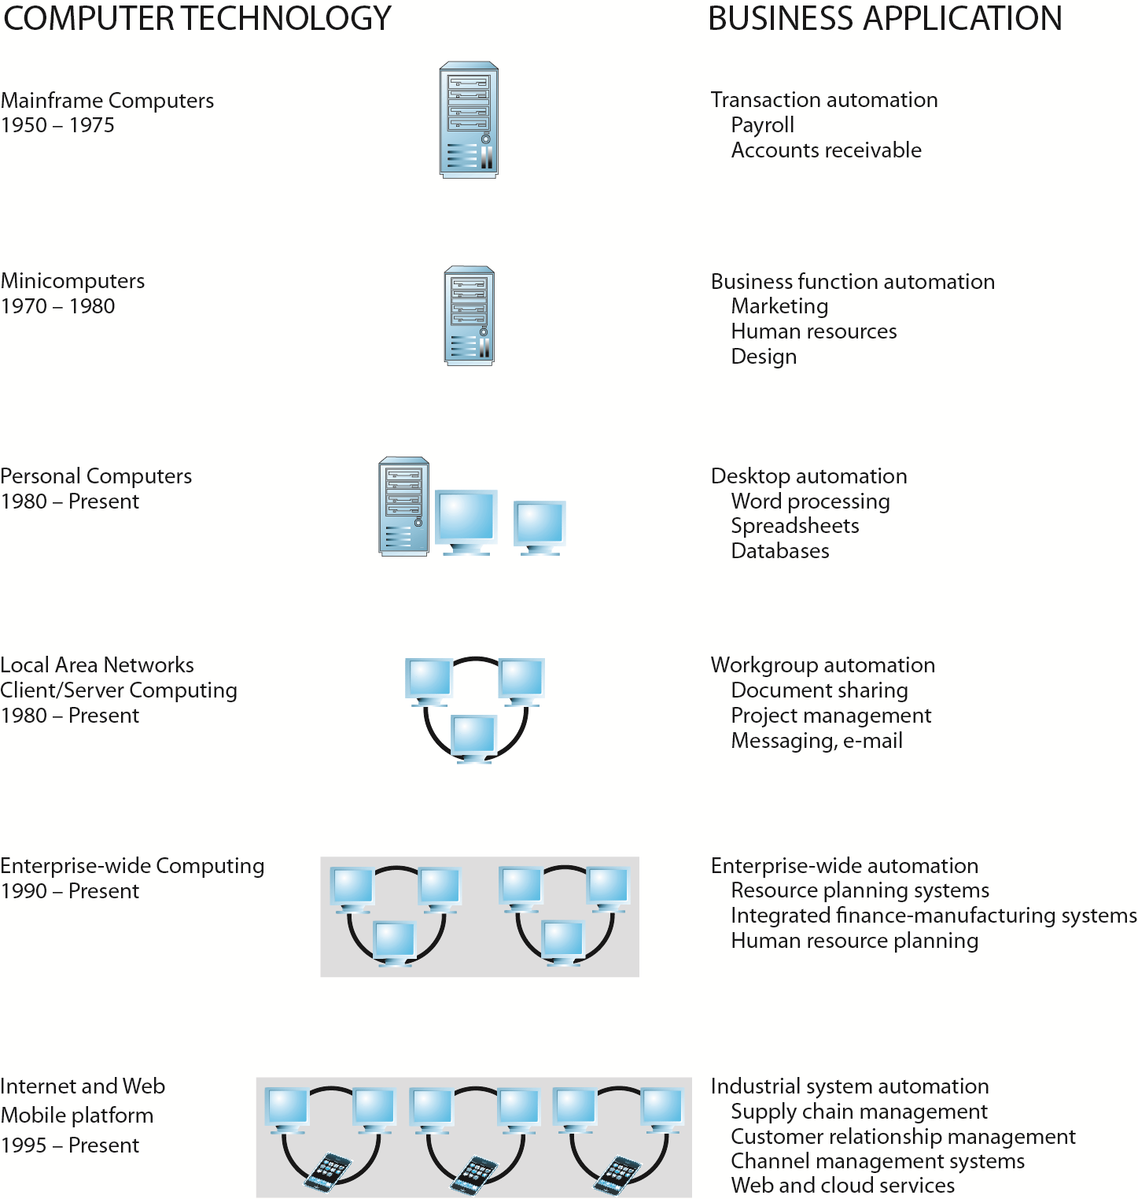
The Internet and the Evolution of Corporate
Computing
Slide 1-<number>
Copyright © 2014 Pearson Education, Inc. Publishing as Prentice Hall

Slide 41
Facebook and the Age of Privacy
Why are social network sites interested in collecting user information?
What types of privacy invasion are described in the case? Which is the most privacy-invading, and why?
Is e-commerce any different than traditional markets with respect to privacy? Don’t merchants always want to know their customer?
How do you protect your privacy on the Web?

Slide 42
Academic Disciplines
Concerned with E-commerce
Technical approach
  Computer science
  Management science
  Information systems
Behavioral approach
  Information systems
  Economics
  Marketing
  Management
  Finance/accounting
  Sociology

